Slide 1
Retrieving Our Resistance: Graphic Novel Project Inspired by Wake
Steps 1 & 2

Slide 2
Quickwrite:
We all know that lying involves saying something that’s not true.
But instead of lying, have you ever just left out part of a story?
Do you consider that a kind of lying? Why or why not?
Why might a person choose NOT to include certain information in a story?

Slide 3
Vocabulary:
Omit: leave out or exclude (someone or something), either intentionally or forgetfully.
Lie of omission: occurs when an important fact is left out in order to foster a misconception.
Bias: prejudice in favor of or against one thing, person, or group compared with another, usually in a way considered to be unfair.
Discussion Questions:
Have you ever experienced bias or omission in a history class before?
Have you ever felt like an official source wasn’t telling you the whole story?
Notes:
Extension: https://www.nytimes.com/interactive/2020/01/12/us/texas-vs-california-history-textbooks.html

Slide 4
“History written by the victors always erases resistance. And those of us who live in the wake / ruins learn that we were inferior and needed to be conquered and enslaved.
This is the afterlife of slavery that the victors need us to inhabit.
One in which we have already lost and have accepted our fate as handed to us.”
Dr. Rebecca Hall, Wake
Discussion Question:
What is the relationship between bias in historical narratives and the present day- according to this author?
Notes:
Could be annotated? Who are the “victors”? What is “resistance”? What is it to “live in the wake”? What have we “lost”?

Slide 5
“We must defend the dead and fight the violence inflicted on them by erasure from the historical record.”
“When we go back and retrieve our past, our legacy of resistance through impossible odds, our way out of no way, we redress the void of origins that would erase us. We empower and bring joy to our present. This is ancestry in progress, and it is our superpower. “
Project Retrieving Our Resistance: Graphic Novel Project Inspired by Wake
‹#›
Notes:
Honor the dead - Christina Sharpe In the Wake

Slide 6
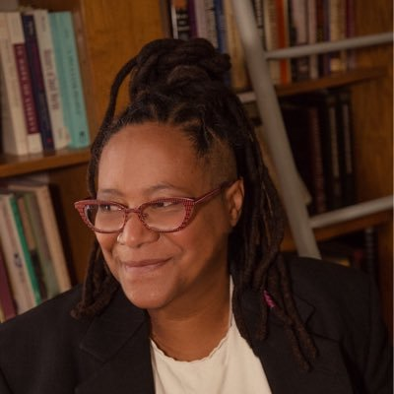
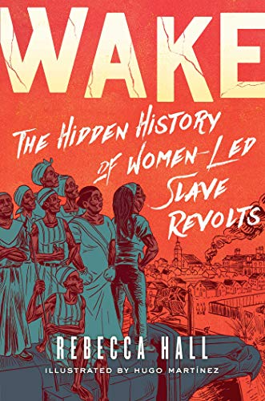
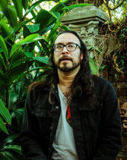
Project Overview:
In this project, students will examine local primary sources, looking for hidden stories of resistance.
Students will research these stories and write their own, “critically fabulated” version of events, in the form of a graphic novel.
Inspired by the graphic novel Wake: The Hidden History of Women-Led Slave Revolts by Dr. Rebecca Hall
Illustrated by Hugo Martinez

Slide 7
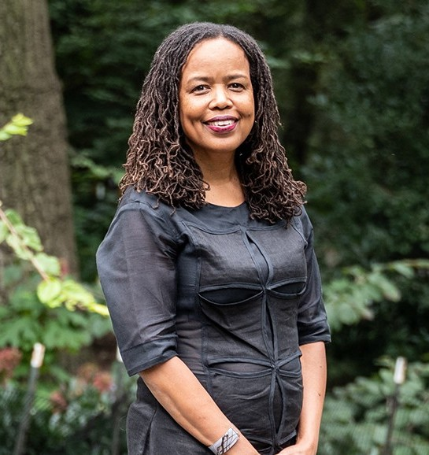
Vocabulary:
critical fabulation:
Coined by scholar Saidiya Hartman
a semi-nonfiction style of writing that attempts to bring the suppressed voices of the past to the surface by means of hard research and scattered facts.
Listen to MoMa interview with Saidiya Hartman
Question: What are her goals in her work?
Notes:
Read: https://www.moma.org/audio/playlist/298/4088
Listen: https://www.moma.org/collection/works/427132

Slide 8
Project Steps
Step 1: Students analyze primary source historical texts, identifying key missing information and biases in the text.
Step 3: Student “critically fabulates” a semi-nonfictional narrative version of events, based on available historical information.
Step 2: Students thoroughly research a local historic event of their choosing. Students identify key information about the historical agents in this event, acknowledging where key information cannot be located.
Step 4: Students collaborate to create a graphic novel narrative of their selected event.
Students reflect on their research process.
Notes:
http://www.corestandards.org/ELA-Literacy/RH/11-12/

Slide 9
Step 1:
How do we identify silences in historical texts?
What is the important information in a story?
Look for key information that is missing! Hint: look for personhood and agency

Slide 10
What is Personhood?
What is Agency?
The state or fact of being a person.
The state or fact of being an individual or having human characteristics and feelings.
Look for: Who is named? Whose feelings and motivations are described?
The capacity, condition, or state of acting or of exerting power.
The ability to take action or to choose what action to take.
Look for: Who is taking action? Who is acted upon?
Notes:
Source: Dictionary.com, Merriam Webster

Slide 11
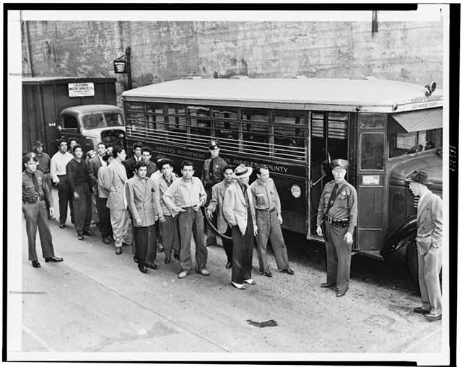
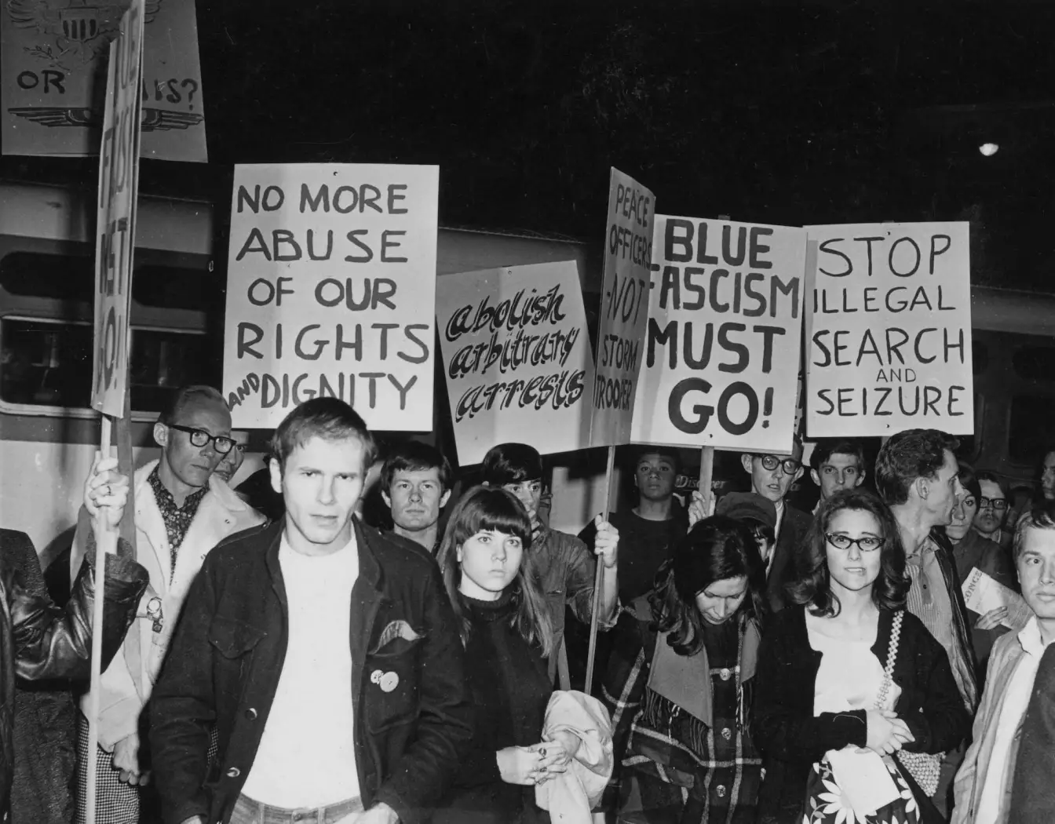
Step 1: Reading about Two Historical Incidents
Let’s practice reading official texts about two historical incidents in Los Angeles:
Zoot suiters lined up outside Los Angeles jail en route to court after feud with sailors "Zoot suits". 1943. Library of Congress Prints and Photographs Division.
Protests outside the Black Cat bar, Feb. 11, 1967. Photo courtesy of the ONE National Gay and Lesbian Archives at the USC Libraries.
Notes:
Ask students to look at photos and wonder, generate questions - use as hook.

Slide 12
Background: The Zoot Suit Riots
Summer of 1943, series of anti-Mexican riots, or attacks.
Began when 11 servicemen claimed that they were attacked by zoot suit wearing youth.
Thousands of white servicemen attacked, stripped, beat mostly Mexican American youth in zoot suits.
Media and law enforcement overtly took the side of the servicemen.
Notes:
Be critical of what images you use when providing background of events like this, if you choose to use disempowering images where people are being brutalized, consider your reasons for doing so and discuss with students.

Slide 13
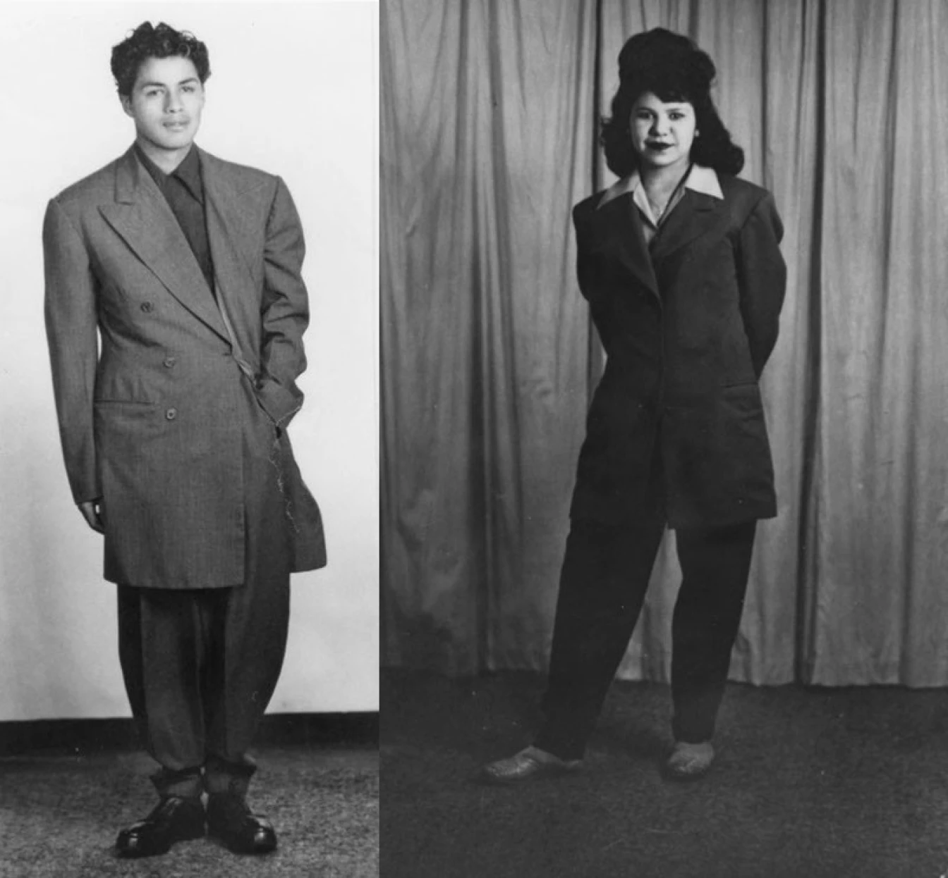
Vocabulary: Pachucos
Pachuco is a politicized term.
Simple definition (first on google): Gangster, thug.
Counter-culture of resistance, influence from African Americans, Indigenous, many cultures.
Zoot suit had jazz roots, anti-war implications.
LA City officials hated multiracial pachuco jazz parties.
LA City Council tried to pass law banning white teens from attending.
Notes:
https://www.kcet.org/shows/artbound/pachucos-not-just-mexican-american-males-or-juvenile-delinquents
A young man named Frank wears his "drapes," a variation on the zoot suit style, 1944. | Photo: Courtesy of the Los Angeles Public Library/Shades of L.A. Collection

Slide 14
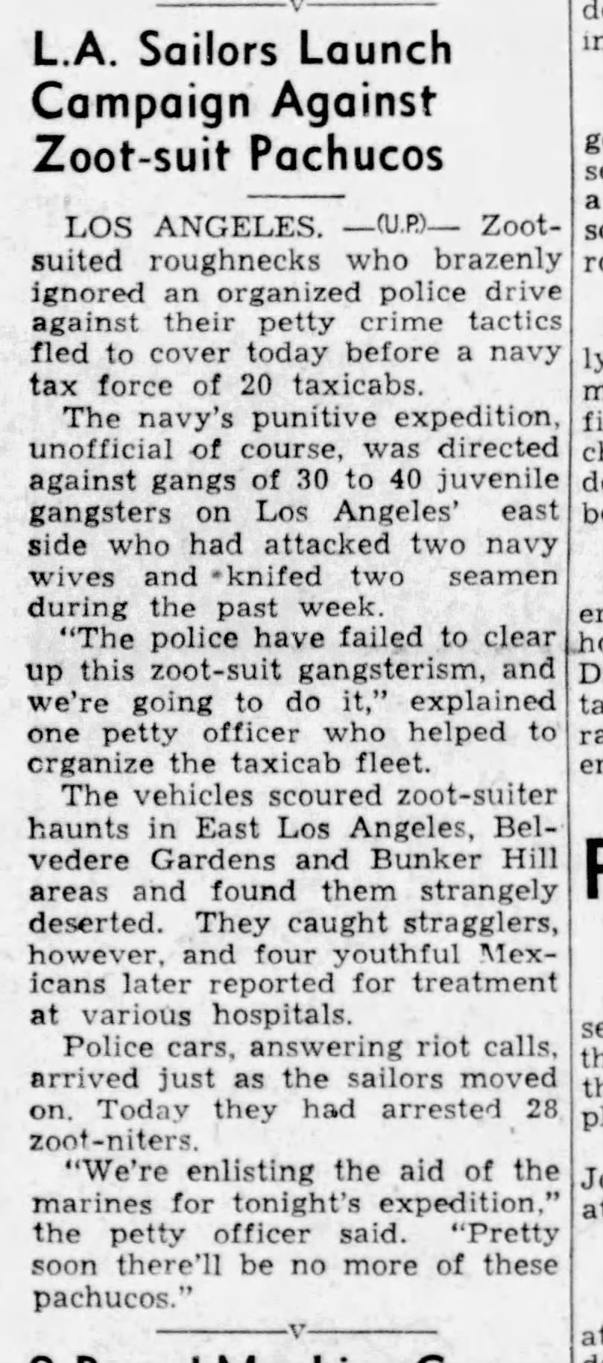
Analyzing Text: The Zoot Suit Riots
Let’s read an official account of this event.
Title: L.A. Sailors Launch Campaign Against Zoot-suit Pachucos
Publication info:
Ventura County Star (Ventura, California) on Monday June 7th, 1943.
Pre-Reading Sourcing: Make a prediction
How might the person, time, place, audience or purpose influence this text?
Then: Let’s read together.
Notes:
Reading: https://drive.google.com/file/d/15PECazJcC0DSuD-TsRiPRU5i1aPhN4eb/view?usp=sharing
Graphic Organizer: https://docs.google.com/document/d/18GXDZF7KDmjmPLtegK9N2ap8y4emxNbKOA4U7PewGbg/edit?usp=sharing

Slide 15
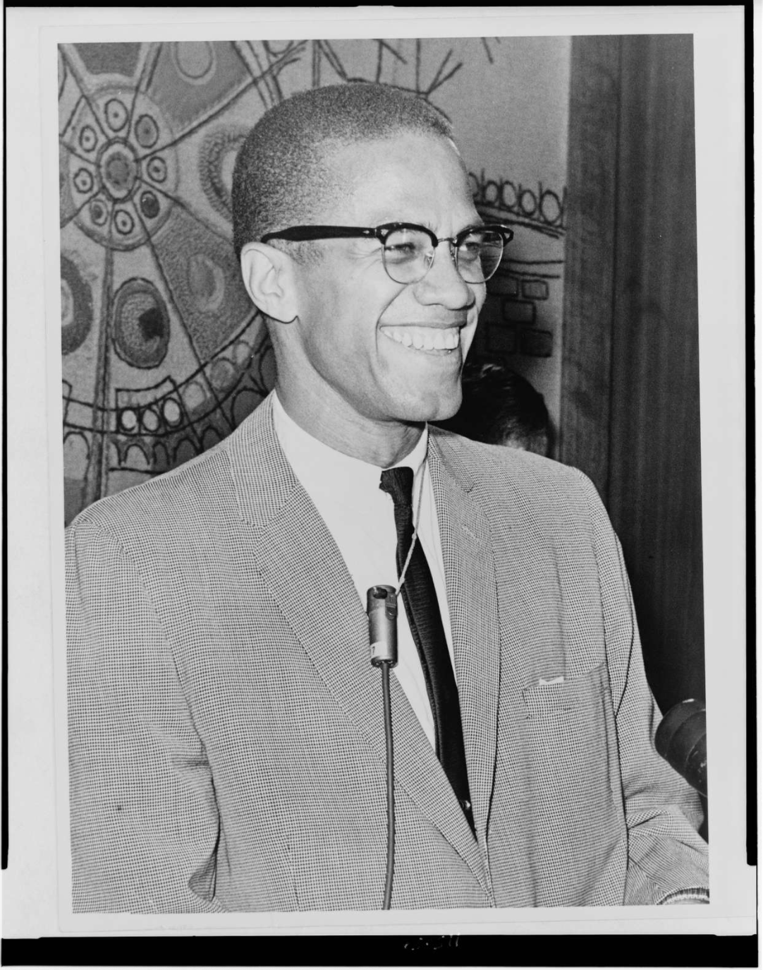
Exit Ticket Reflection:
Malcolm X once said:
“If you're not careful, the newspapers will have you hating the people who are being oppressed, and loving the people who are doing the oppressing.”
What do you think he might have meant by that?
Does this relate to your readings today?
What does it mean to be “careful”? What should we do?
What do you think so far?

Slide 16
Step 2:
How do we recover voices lost in the historical record?
What information can we find about our humanity, agency and resistance?
Research, Interviews, Evaluating Sources

Slide 17
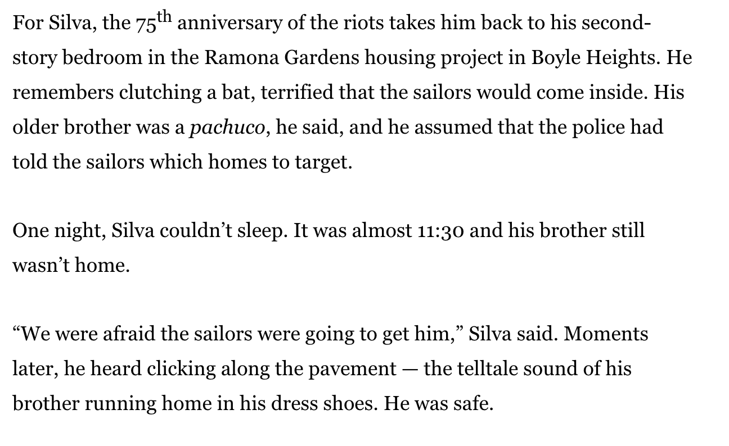
Excerpt from a recent Los Angeles Times article reflecting on the legacy of the Zoot Suit Riots:
Notes:
Sample Counter-Narrative Reading: https://www.latimes.com/local/lanow/la-me-ln-zoot-suit-riots-anniversary-20180604-story.html
Can use with Beginning Research Guide: https://docs.google.com/document/d/1UroHcTVCqkyFxGjoip6ab-cmji6HonEM76hVRTSWg1w/edit?usp=sharing

Slide 18
Discussion:
We know that the official sources on these stories gave us an incomplete history.
Our task is to identify:
What kind of information do we need to find?
Where are we likely to find that information?
What do you think so far?

Slide 19
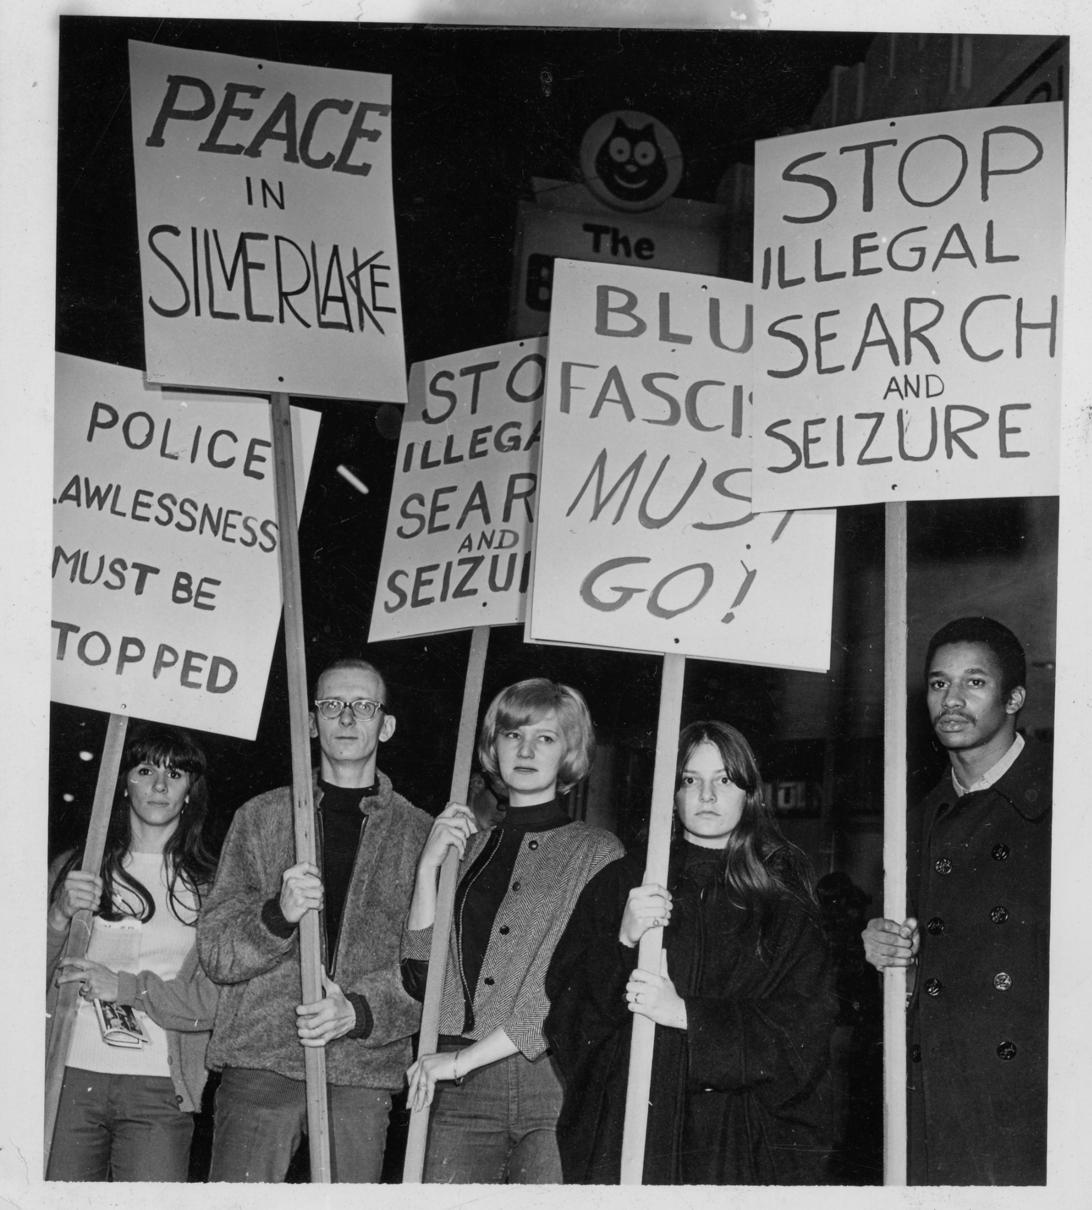
Background: The Black Cat Tavern Riots
NYE 1967 Police raided the Black Cat Bar, beat and arrested patrons.
Organization PRIDE (Personal Rights in Defense and Education) held a protest against police brutality in response in Feb 1967.
Significant early action in LGBTQ history.
Notes:
Outside the Black Cat on February 11, 1967
Photograph: Courtesy ONE Archives at the USC Libraries

Slide 20
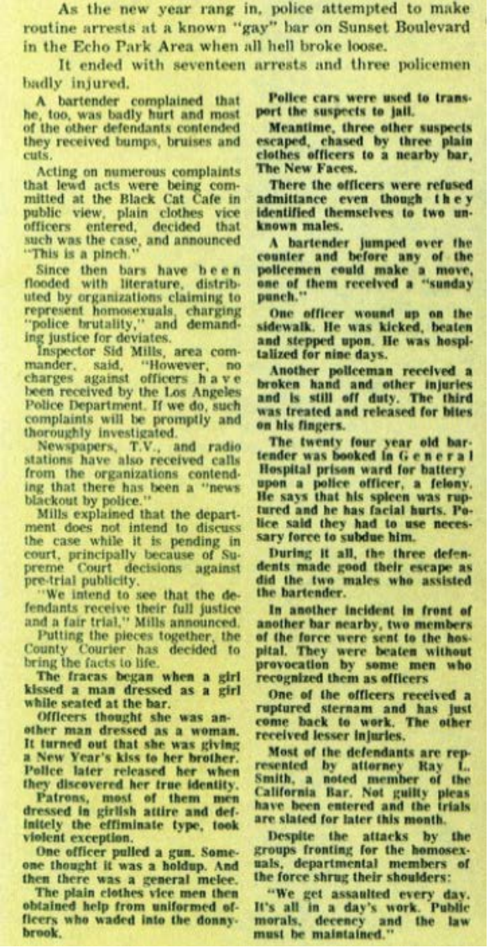
Analyzing Text: The Black Cat Riots
Let’s read an official account of this event.
Title: Tavern Charges Police Brutality
Publication info:
County Courier: The Voice of Los Angeles, January 19th 1967.
Pre-Reading Sourcing: Make a prediction
How might the person, time, place, audience or purpose influence this text?
Then: Let’s read together.
Notes:
Reading: https://docs.google.com/document/d/18UPj76VhrPl0jme4G-wooJr9xvbuLJpAcmCtNdmuQtg/edit?usp=sharing
Graphic Organizer: https://docs.google.com/document/d/18GXDZF7KDmjmPLtegK9N2ap8y4emxNbKOA4U7PewGbg/edit?usp=sharing

Slide 21
Step 2: Recovering Information about Two Historical Incidents
The Zoot Suit Riots
The Black Cat Tavern Riots
Yesterday, we read sources about two historical incidents:
Zoot suiters lined up outside Los Angeles jail en route to court after feud with sailors "Zoot suits". 1943. Library of Congress Prints and Photographs Division.
Protests outside the Black Cat bar, Feb. 11, 1967. Photo courtesy of the ONE National Gay and Lesbian Archives at the USC Libraries.

Slide 22
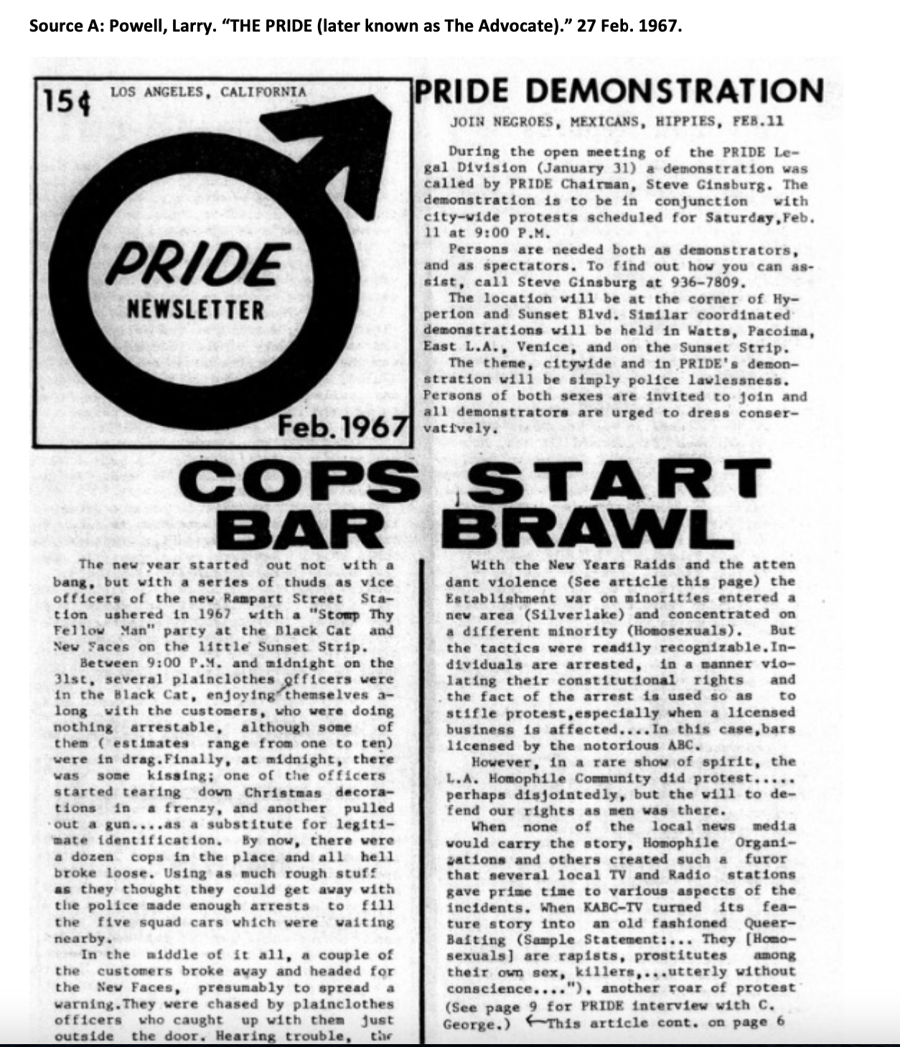
Article from publication The PRIDE Newsletter, days after event.
Becomes The Advocate, historic LGBT paper.
Title: “Cops Start Bar Brawl”.
Notes:
Sample counter-narrative Source A: https://www.onearchives.org/wp-content/uploads/2019/02/one-archives-foundation-black-cat-riots.pdf
Thanks to educator Miguel Covarrubias and the ONE Archives for above lesson materials.
Can use with Beginning Research Guide: https://docs.google.com/document/d/1UroHcTVCqkyFxGjoip6ab-cmji6HonEM76hVRTSWg1w/edit?usp=sharing

Slide 23
Additional Research
Did those sources answer all of your questions about this event?
What else do we need to learn to better understand the people involved?
What other kinds of sources should we search for?
Notes:
Annotated Bibliography
Research Reflection

Slide 24
Extension Option:
Interviews & Oral History
Students can conduct interviews with local residents, family or community members about these events.

Slide 25
Bibliography and Further Reading:
Secondary Sources:
Hartman, Saidiya V. Lose Your Mother: A Journey Along the Atlantic Slave Route. New York: Farrar, Straus and Giroux, 2007.
Licón, G. (2022, March 29). Pachucos: Not just Mexican-american males or juvenile delinquents. KCET. Retrieved April 29, 2022, from https://www.kcet.org/shows/artbound/pachucos-not-just-mexican-american-males-or-juvenile-delinquents
Macías, Anthony. “Bringing Music to the People: Race, Urban Culture, and Municipal Politics in Postwar Los Angeles.” American Quarterly, vol. 56, no. 3, 2004, pp. 693–717, http://www.jstor.org/stable/40068239. Accessed 30 Apr. 2022.

Slide 26
For more information or to get involved
Contact us!
www.idabwellseducationproject.org
Facebook: https://www.facebook.com/IdaBWellsEducationProject Twitter: @IdaBWellsEdProj
Email: info@idabwellseducationproject.org

Slide 27
© Lesson Plans Copyright 2022
Content may be reproduced with credit to the Ida B. Wells Education Project.
All materials are made publicly available for teaching, learning, educational and personal use only. We are a community of educators sharing materials for the purpose of furthering education on these topics.
Items may be protected by the U.S. Copyright Law (Title 17,U.S.C.). Usage of some items may also be subject to additional restrictions imposed by the copyright owner and/or the producing institution.

